Slide 1







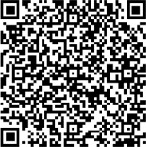


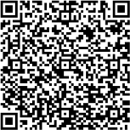
Download the Everbridge 360
Application
Mobile
Receive important communications and use Safety buttons
on your mobile device.
Here are some quick tips to help you get started. Click or scan the QR code
under each topic for a video walk-through. For more
in-depth learning, refer to the Everbridge 360 Mobile App Guide.
Open 'Appstore' on an iOS device or 'Play Store' on an Android device.
Open the Everbridge Mobile App and familiarize your self with its layout.
Search for ‘Everbridge 360' and download Everbridge
360 Mobile App.
Note the system and Safety buttons your organization has enabled for you.
Open the app and enter your Organization’s code to
access the login page
If enabled, review and confirm your Contact Profile
information.
Enter your login credentials and allow the app access to the prompted permissions.
Review and confirm your Location Settings.
Complete any Safety Settings you are prompted to configure.
Depending on the Organization, you may see different Safety buttons configured for you.
Tap on the appropriate Safety buttons to make use of the Safety features.

