Slide 1


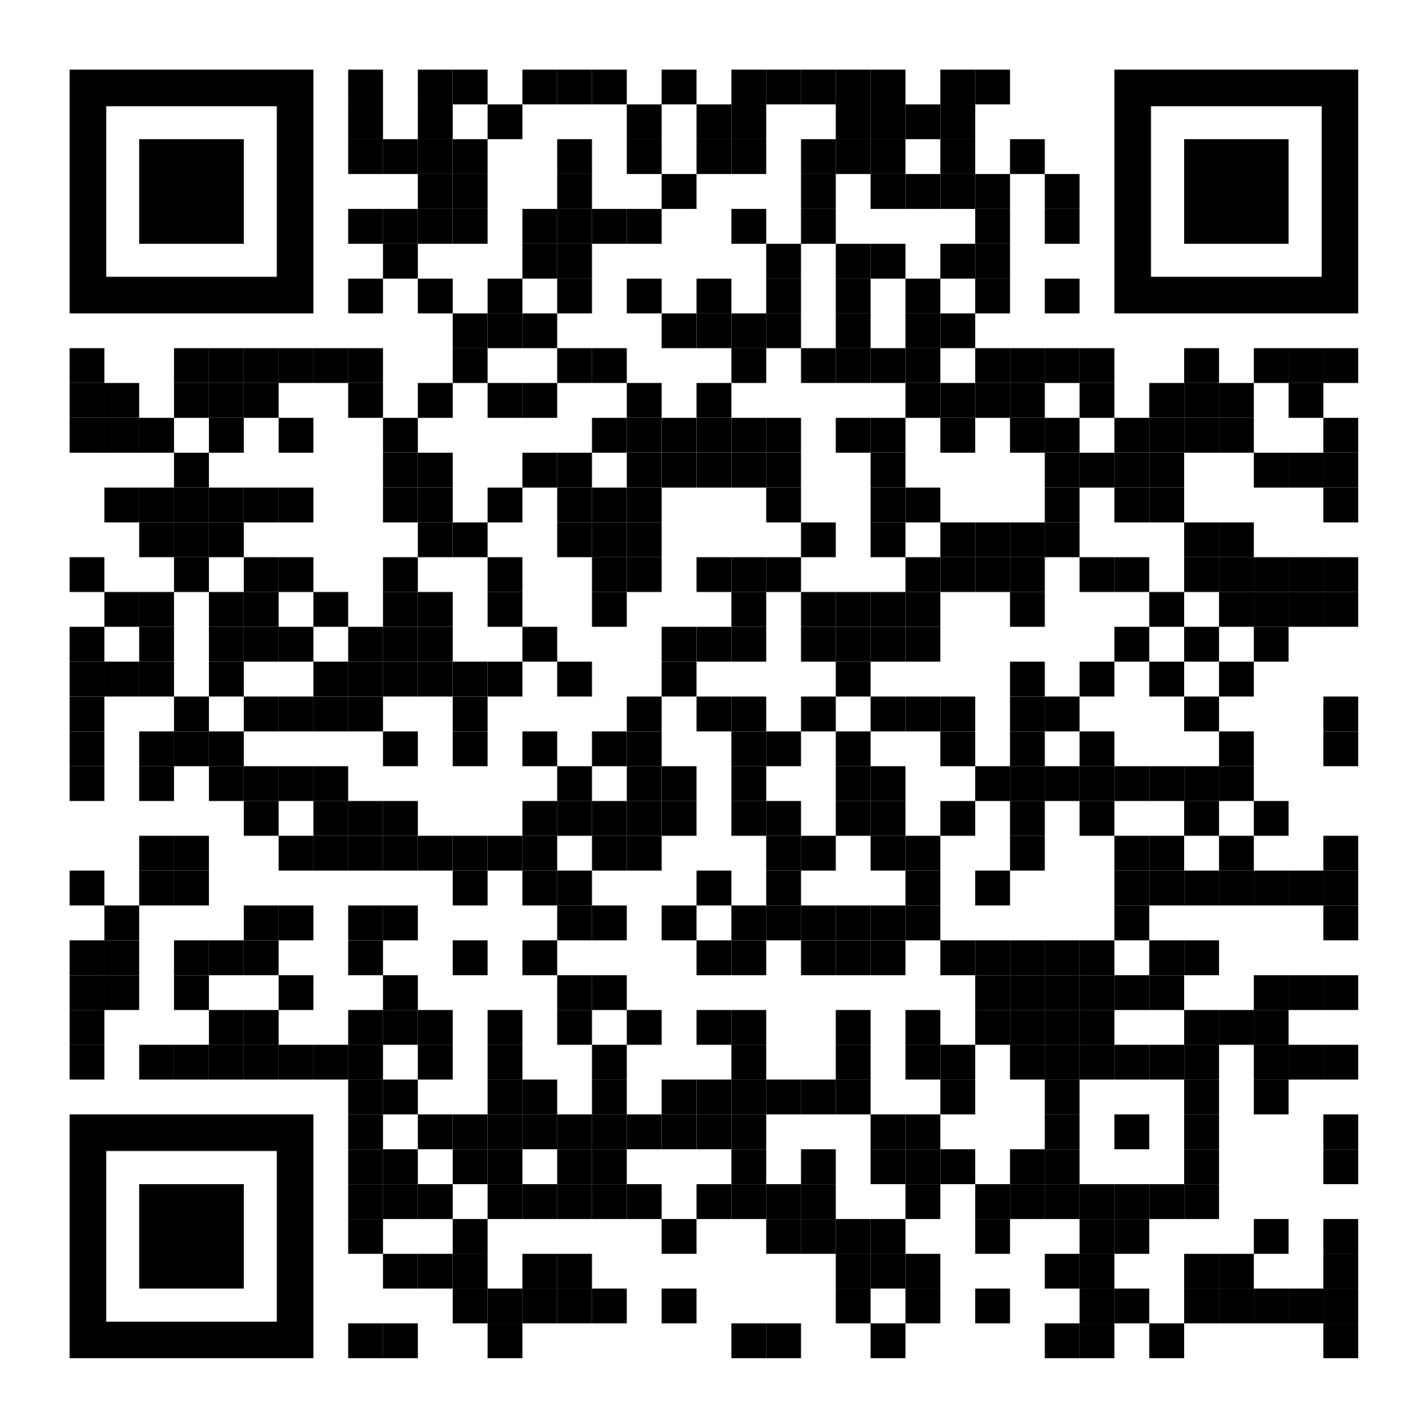

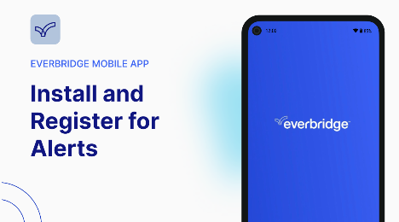
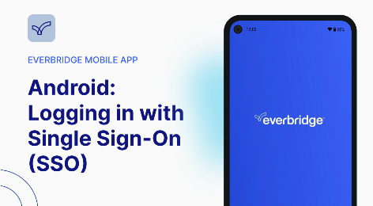

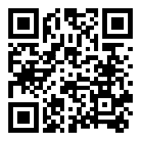
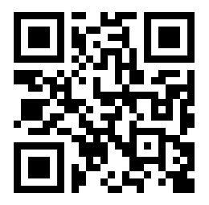
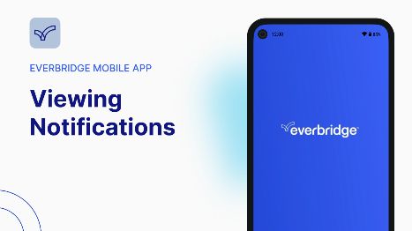
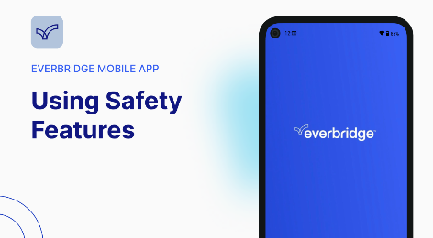

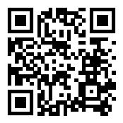
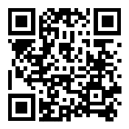


Download the Everbridge Mobile Application to receive important notifications on your mobile device.
Here are some quick tips to help you get started with the Everbridge Mobile Application. For more in-depth learning, refer to the Everbridge Mobile App User Guide, or enroll in Everbridge University.
Click or scan the QR code under each topic for a video walk-through.
Open 'Appstore' on an iOS device or 'Play Store' on an Android device.
Open the Everbridge Mobile App and tap on ‘Find an Organization or subscription’.
Search for 'Everbridge' and download Everbridge Mobile App.
Search for your Organization by entering its keywords provided keyword.
Register with your User ID and password.
Enter your SSO credentials and complete security authentication to log in.
Notifications can be viewed from the ‘Feed’ page. Simply tap a Notification.
Open the Everbridge Mobile App and tap on the shield icon at the bottom right.
Some Notifications require you to confirm that you received the message.
Depending on the Organization, you will see different Safety buttons configured for you.
Organizations may also use ‘Incidents’ and ‘Critical Events’ to send Notifications.
Tap on the appropriate Safety buttons to make use of the Safety features.

