Slide 1
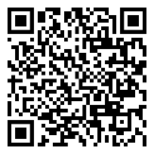
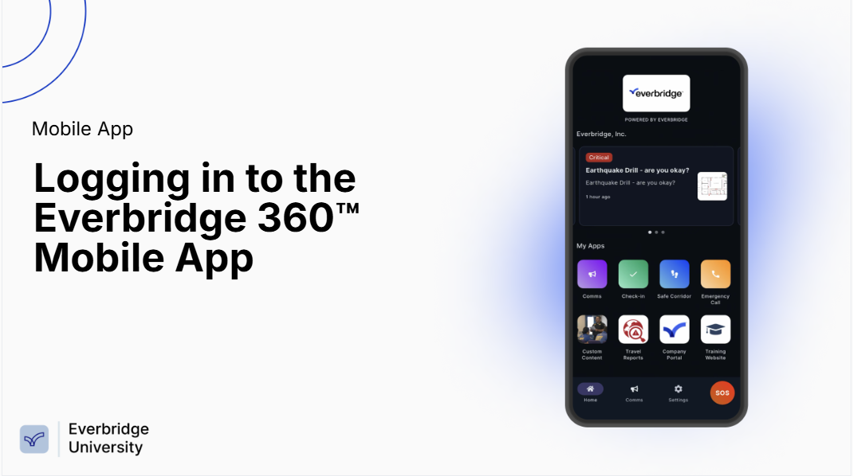
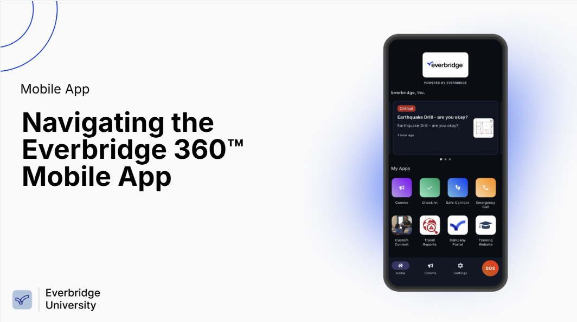
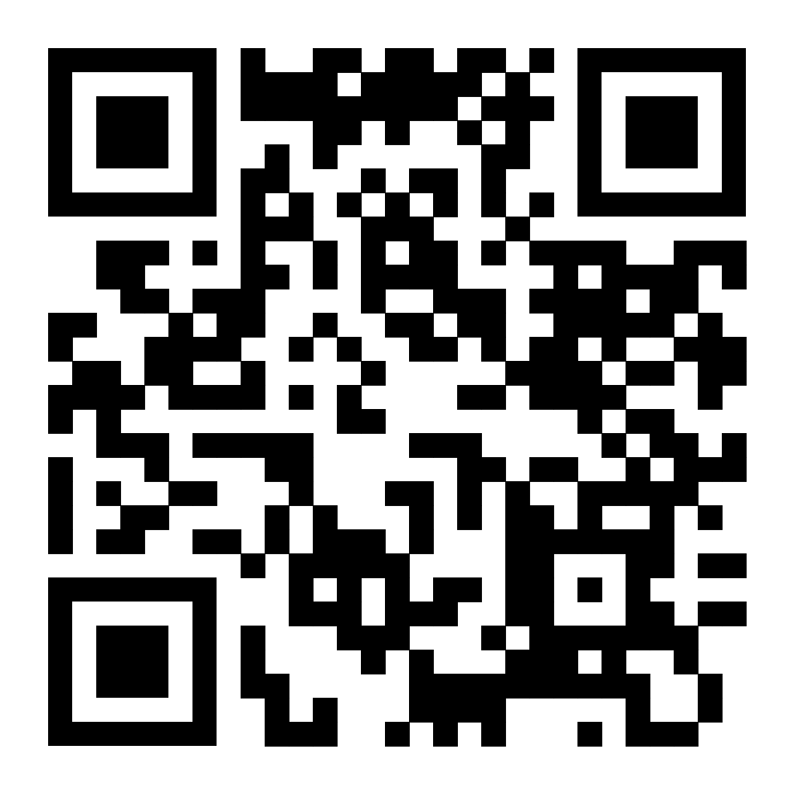
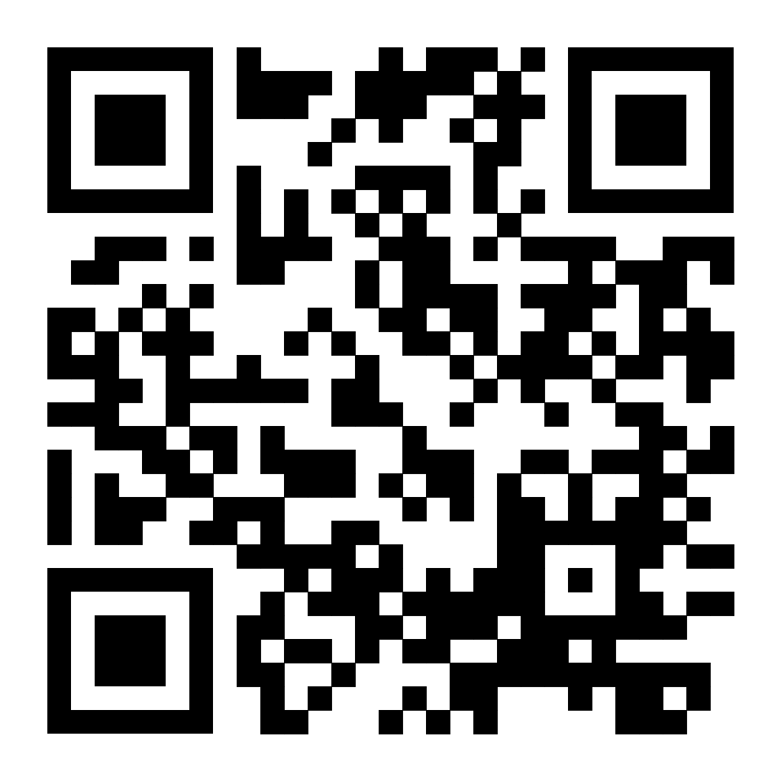
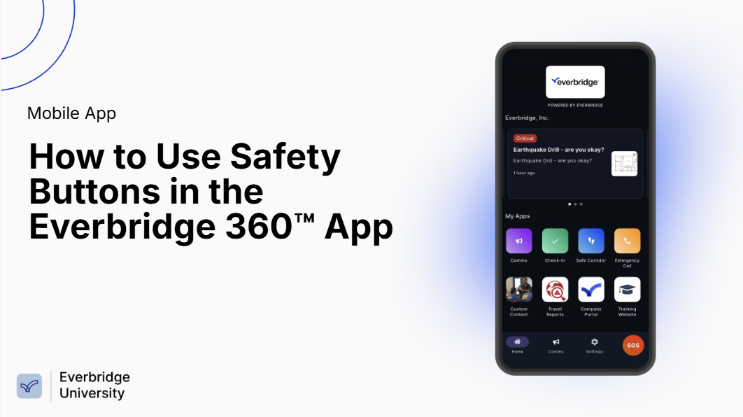
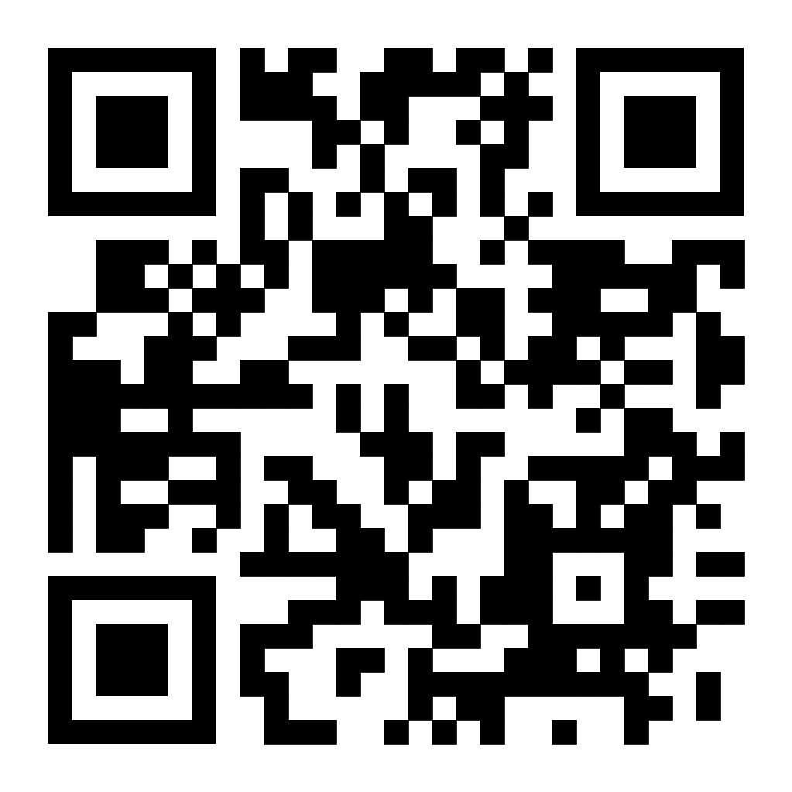
Download the Everbridge 360™ Mobile Application to receive important communications and use Safety buttons on your mobile device.
Here are some quick tips to help you get started with the Everbridge 360™ Mobile Application.
Click or scan the QR code under each topic for a video walk-through.
For more in-depth learning, refer to the Everbridge 360™ Mobile App Guide.
Open 'Appstore' on an iOS device or 'Play Store' on an Android device.
Open the Everbridge Mobile App and familiarize your self with its layout.
Search for ‘Everbridge 360' and download Everbridge 360 Mobile App.
Note the system and Safety buttons your organization has enabled for you.
Open the app and enter your Organization’s code to access the login page
If enabled, review and confirm your Contact Profile information.
Enter your login credentials and allow the app access to the prompted permissions.
Review and confirm your Location Settings.
Complete any Safety Settings you are prompted to configure.
Depending on the Organization, you may see different Safety buttons configured for you.
Tap on the appropriate Safety buttons to make use of the Safety features.

